Slide 1
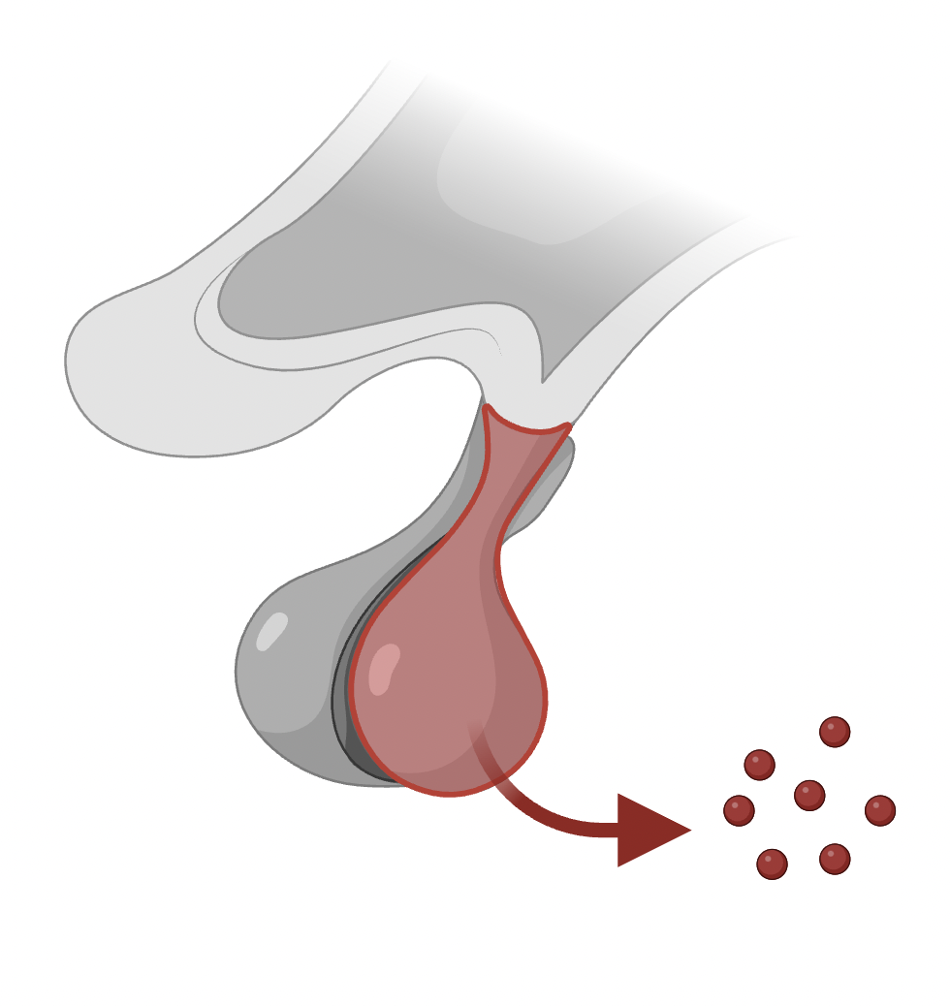
What is AVP-D/CDI?
Pituitary gland
Vasopressin
Notes:
Instead, CDI/AVP-D is due to deficiency of a hormone called vasopressin, produced from the pituitary gland.

Slide 2
What is AVP-D/CDI?
=
Arginine vasopressin deficiency (AVP-D)
Cranial diabetes insipidus
Diabetes mellitus (type 1 or type 2 diabetes)
Notes:
Cranial diabetes insipidus is now also known as arginine vasopressin deficiency (AVP-D).
AVP-D is often confused with diabetes mellitus. However, AVP-D is not related to blood sugar levels.

Slide 3
Symptoms
Passing lots of urine, even at night (polyuria)
Excessive thirst (polydipsia)
Notes:
Deficiency of vasopressin leads to increased urine frequency up to 10 litres per day (polyuria) and excessive thirst (polydipsia). Untreated, AVPD can lead to severe dehydration and risk of death.

Slide 4
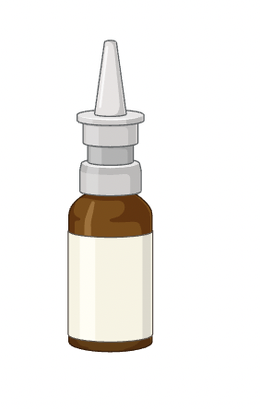
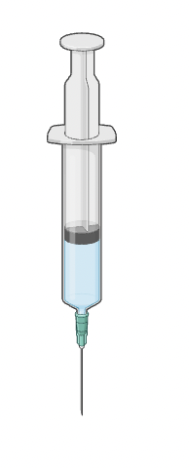
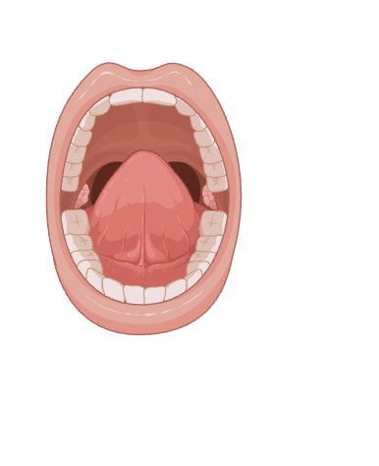
Treatment
The treatment for CDI/AVP-D is desmopressin.
Life threatening dehydration and hypernatraemia
Desmopressin is a critical drug.
Notes:
The treatment for CDI/AVP-D is desmopressin.
It is usually given in tablet form but some patients can be on other preparations such as nasal sprays, sublingual or injections.
Desmopressin dose should never be missed or delayed as this can lead to some patients passing 5-10 litres of urine per day. The resulting dehydration can cause severe hypernatraemia and risk of death.
Due to this, desmopressin is a critical drug.

Slide 5
Audit findings
10%
11%
5.6 hours
14.4 hours
Notes:
An audit conducted within Sheffield Teaching Hospitals found that:
10% of desmopressin doses were missed.
10.9% of desmopressin doses were delayed.
The median time to prescription was 5.6 hours.
The median time to administration was 14.4 hours.

Slide 6
Interventions
Critical drug
Alerts
Local registry
Staff survey
Notes:
Desmopressin is now listed as a critical drug and available on all medical wards.
New alerts have bee added to EPMA with a reminder to contact endocrinology
STH Desmopressin registry is in development.
Qualitative staff survey has been conducted at STH which shows inadequate knowledge among doctors and nurses.

